Slide 1
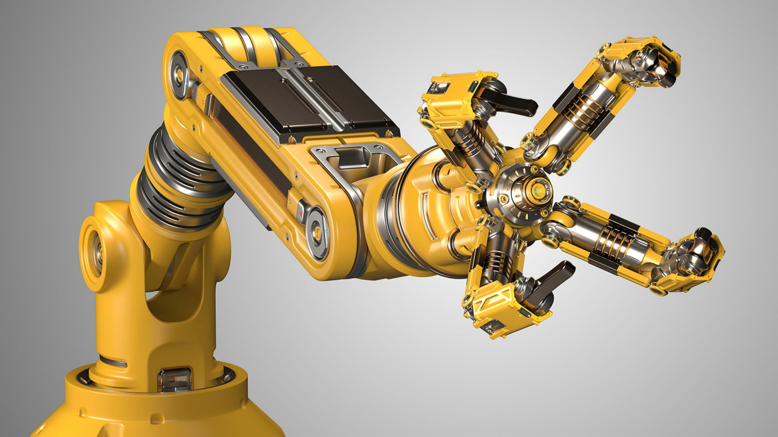
Teaching Robots: Uncovering User Preferences and Interaction
Patterns
Konstantinos Christofi
Supervisor: Dr. Kim Baraka

Slide 2
Contents
Add Text
Limitations & Future Work
Motivation
Methodology
Results
Add Text
Research Questions
Study Design
Discussion

Slide 3

Understanding the dynamics of how humans interact and especially teach robots.
Understanding how humans provide Demonstrations and Feedback to instruct a robotic arm
1
2
Exploring strategic decisions of teachers on when and how to intervene
3
4
Optimizing Robot Learning
Motivation
Development of oracles – simulated human teachers
5

Slide 4
Contents
Add Text
Limitations & Future Work
Motivation
Methodology
Results
Add Text
Research Questions
Study Design
Discussion

Slide 5
Research Questions
Research Question
“Are there consistent patterns in teaching behaviors in user interactions with a robot?”
“How do users' interaction patterns with a robot vary, and what is the timing of teaching modalities - Demonstrations and Feedback - in human-robot interaction?”
“What influence do demographic variables have on users' preferences for teaching modalities, and how do these variables shape users' interaction patterns?”
“What are the essential factors that guide users' choices between demonstrations and feedback, and how do these factors impact the dynamics of user-driven interactions?”

Slide 6
Contents
Add Text
Limitations & Future Work
Motivation
Methodology
Results
Add Text
Research Questions
Study Design
Discussion

Slide 7
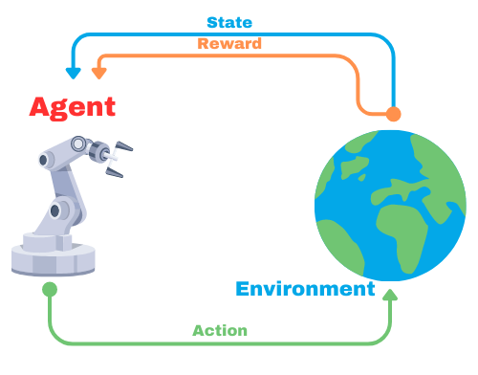
Background Information
Reinforcement Learning
Learning Paradigm where agents learn by interacting with an environment
Receiving feedback in the form of rewards
Adjusting their decisions to maximize the cumulative rewards over time
Used Techniques
Learning from Demonstration
Reinforcement Learning Methods:
Policy Shaping
Q-Learning

Slide 8
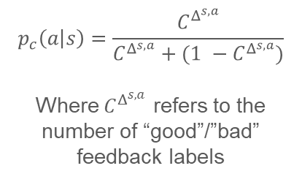
Policy Shaping
Human Input → Assessment of the course of action
The probability this action to be selected is calculated by:
Human Teacher → “Good”/ “Bad” feedback
Makes learning more effective
Allows human teacher to directly affect the behavior of the learning agent by providing positive or negative feedback on specific actions in different states.
$$p_{c}\left(a | s\right)=\frac{C^{Δ^{s, a}}}{C^{Δ^{s, a}}+(1 −C^{Δ^{s, a}})}$$
Where $C^{Δ^{s, a}}$ refers to the number of “good”/”bad” feedback labels
After the agent takes an action to a state
Can potentially accelerate the convergence to optimal behavior.

Slide 9
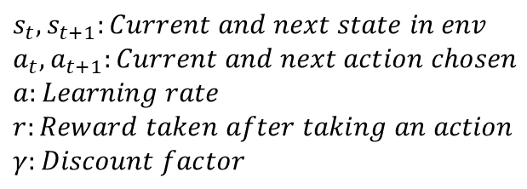
Q-Learning and Markov Decision Processes (MDPs)
Markov Decision Processes (MDPs)
Aims to find an optimal policy
Decision-making process in uncertain environments
Agent → Takes actions → Receives Rewards
Guides the agent’s action to maximize it’s expected cumulative rewards
Updating estimates of action values (Q-Values)
Expected cumulative rewards of taking a specific action in each state
Q-Learning Algorithm
$$s_{t}, s_{t+1}:Current and next state in env$$
$$a_{t}, a_{t+1}:Current and next action chosen$$
$$a:Learning rate$$
$$r:Reward taken after taking an action$$
$$γ:Discount factor$$
Fundamental algorithm in RL
Operates within the framework of MDPs
$Q_{new}\left(s_{t},a_{t}\right)=Q\left(s_{t},a_{t}\right)+α [r_{t}+γ \max_{a_{t+1}}Q\left(s_{t+1},a_{t+1}\right) −Q\left(s_{t},a_{t}\right)$]

Slide 10

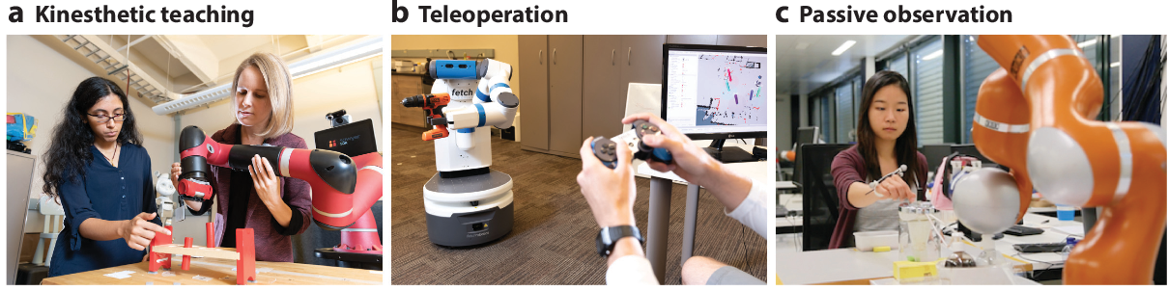
Demonstration
Feedback
Learning from Demonstration (LfD):
Agent → observing and analyzing actions performed by a human teacher → learns a task
Imitation Learning → agent aims to directly replicate the expert’s behavior
Inverse RL → use of the reward function from demonstrations to learn a strategy that maximizes the reward
Robot’s/Agent’s Goal:
Leverage the knowledge of human demonstrations → Learn new tasks
Learning from Feedback (LfF):
Human teacher → Evaluative feedback (“Good”/”Bad”) to agent → based on their action

Slide 11
Learning
Algorithm
Action probabilities are computed from Q-values tied to specific states
Softmax function transforms Q-values into a probability distribution
Q-Learning
Calculated feedback-influenced action probabilities
Feedback magnitudes are adjusted
↳ limiting the probability
to actions with negative feedback
Relating feedback values to probabilities → steering away from actions with negative feedback
Policy Shaping
Probabilities from both methods are merged
↳ forming a probability list of actions tied to a state
Stochastic action selection based on the probabilities
Action Selection

Slide 12



Implementation
Graphical User Interface (GUI) design and development
Interaction between human teacher and robotic arm
Panda-Gym environment
OpenAI gym environment inspired
Human teacher takes control of the agent
Demonstrating desired actions corresponding to specific states
Agent’s selection of actions based on calculated probabilities
Human teacher can provide feedback to the agent
↳ Contributing to refining the values in Policy Shaping table

Slide 13
Contents
Add Text
Limitations & Future Work
Motivation
Methodology
Results
Add Text
Research Questions
Study Design
Discussion

Slide 14
Study Design
Pilot Study:
Learning Algorithm was not the primary focus
29 Participants
17 Females and 12 Males
22-51 Years old
Examine the influence of demographic factors of teachers’ interactions with the robotic arm
Follow-up study:
30 Participants
9 Females and 21 Males
22-59 Years old
Examine how different types of teachers can affect robot learning

Slide 15
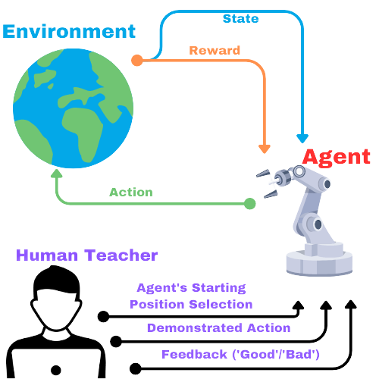
Study Design
Participants interacted with the robotic arm on three different tasks:
Selection of agent’s starting position in environment
Provision of Demonstration / Evaluative Feedback
Limited quota
Termination Criteria
3-minute time limit
Completion of 5 task episodes
Usage of all Demonstration and Feedback steps
100 Demonstration steps
75 Feedback steps

Slide 16
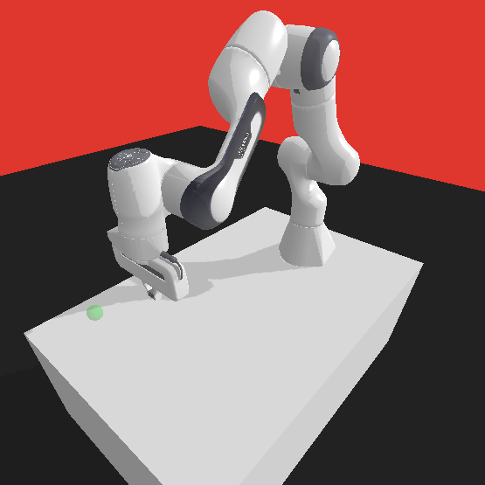
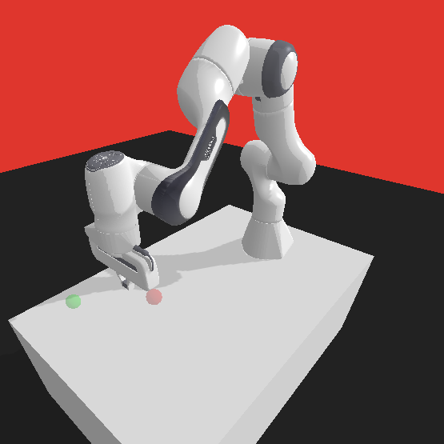
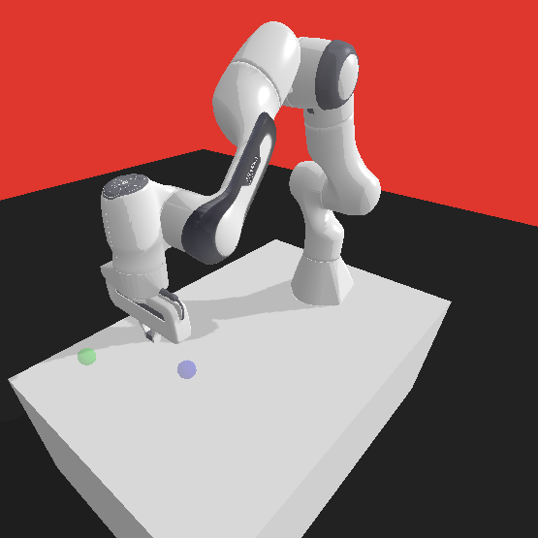
Tasks
Task 1 – Reach Green sphere
Task 2 – Reach Green sphere and avoid the Red one
Task 3 – Reach Blue sphere and the Green one after
Actions taken by the agent → not resulting to the end goal → penalty of -1
Successful arrival at the green sphere
↳ immediate reward of 0
Actions taken by the agent → not resulting to the end goal → penalty of -1
Successful arrival at the green sphere
↳ immediate reward of 0
Actions taken by the agent → resulting touching the red sphere → penalty of -1.5
Actions taken by the agent → not resulting to the end goal → penalty of -1
Successful arrival at the green sphere
↳ immediate reward of 0
Actions taken by the agent → resulting touching the red sphere → penalty of -0.5

Slide 17

Questionnaire
Section 1:
Participants’ overall experience from teaching and their interaction with the robotic arm, e.g.:
“In which situations did you decide to provide Demonstrations?”
“How did you choose the starting positions of the agent (robotic arm)?”
Section 2:
Exploration of participants’ willingness to integrate the robotic arm into their everyday tasks, e.g.:
“I would teach a robotic arm to help with:”
Section 3:
Demographic Questions, e.g.:
Gender
Education Level
Background Questions, e.g.:
“Have you ever owned a pet?”

Slide 18



Data Collection
During users’ interaction with the robotic arm → automated data collection operates in the background
Robot-related data
Timestamps
States
Actions
Q-value [Q(s,a)]
Type of intervention

Slide 19
Contents
Add Text
Limitations & Future Work
Motivation
Methodology
Results
Add Text
Research Questions
Study Design
Discussion

Slide 20
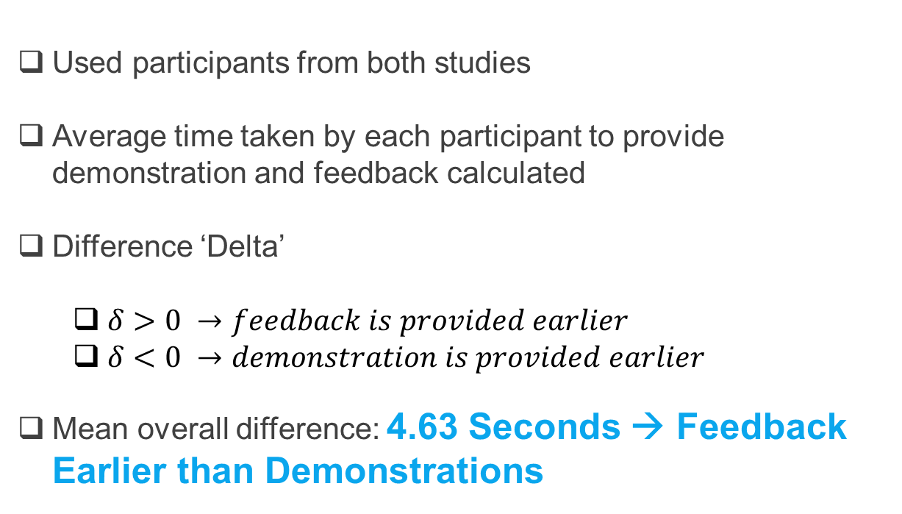
Results
R.Q.: “How do users' interaction patterns with a robot vary, and what is the timing of teaching modalities - Demonstrations and Feedback - in human-robot interaction?”
Used participants from both studies
Average time taken by each participant to provide demonstration and feedback calculated
Difference ‘Delta’
$δ>0 →feedback is provided earlier$
$δ<0 →demonstration is provided earlier$
Mean overall difference: 4.63 Seconds → Feedback Earlier than Demonstrations
$$δ=\overline{{time}_{demonstration}} −\overline{{time}_{feedback}}$$

Slide 21
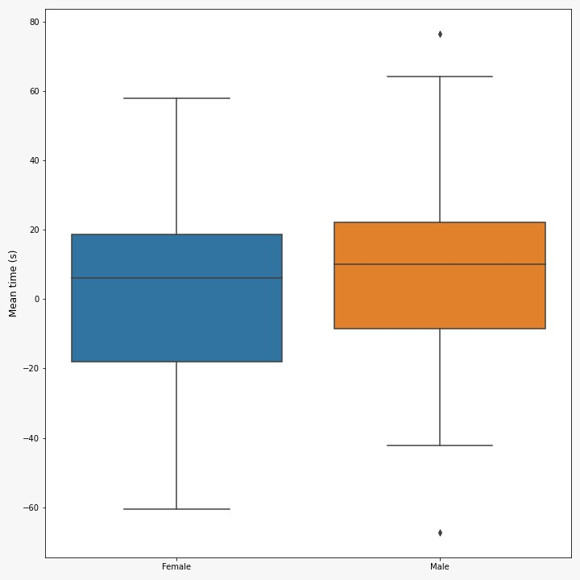
Results
R.Q.: “What influence do demographic variables have on users' preferences for teaching modalities, and how do these variables shape users' interaction patterns?”
Comparison of delta across various demographic variables
Divergence between male and female participants:
Two-sided Rank-Sum test → p-value = 0.42
Female Participants’ mean delta
Male Participants’ mean delta
1.3 seconds (±30.5)
7.4 seconds (±30)

Slide 22
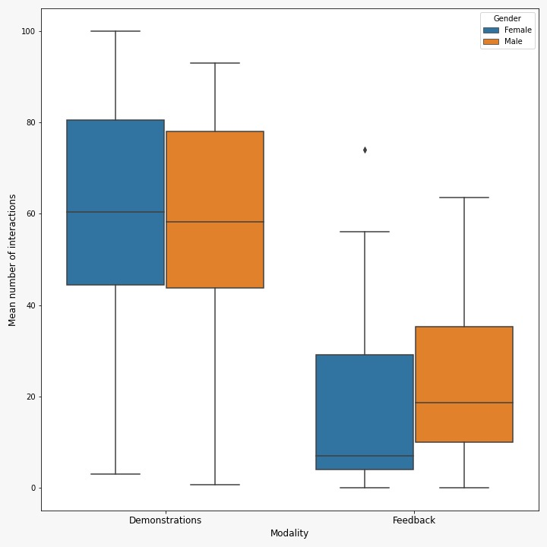
Results
Average number of demonstration and feedback steps provided by each participant
Compared between male and female participants:
Mean Demonstration steps:
Female Participants
Male Participants
60.8 steps (±26.8)
58.9 steps (±23.1)
Two-sided Rank-Sum Test
p-value = 0.74
Mean Feedback steps:
Female Participants
Male Participants
17.3 steps (±19.8)
22.8 steps (±18.4)
Two-sided Rank-Sum Test
p-value = 0.14

Slide 23
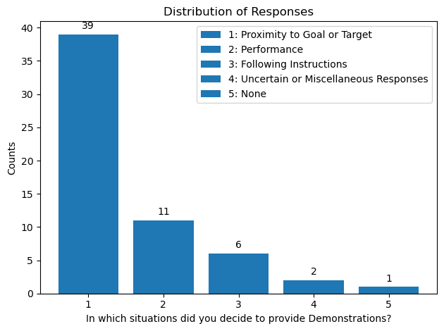
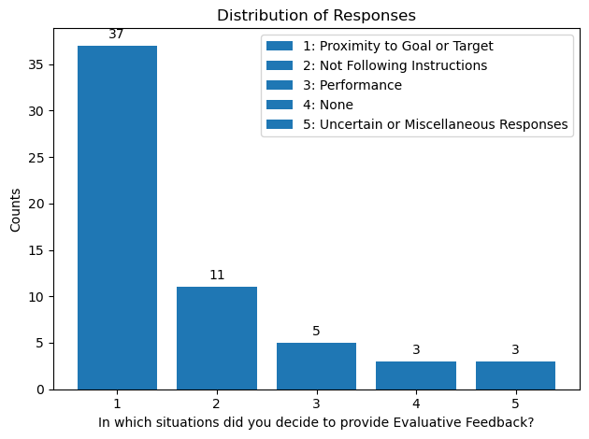
Results
R.Q.: “What are the essential factors that guide users' choices between demonstrations and feedback, and how do these factors impact the dynamics of user-driven interactions?”
Analyzing responses to the questions from the questionnaire:
“In which situations did you decide to provide Demonstrations/Evaluative Feedback?”
Clustering with the assistance of ChatGPT

Slide 24
Results
R.Q.: “How do users' interaction patterns with a robot vary, and what is the timing of teaching modalities - Demonstrations and Feedback - in human-robot interaction?”
R.Q.: “What influence do demographic variables have on users' preferences for teaching modalities, and how do these variables shape users' interaction patterns?”
Average time taken by each participant for their first interaction with the robotic arm
Mean Interaction time: 35.46 seconds (±17.44)
Comparison of average time for first interaction across various demographic variables
Divergence between male and female participants:
Female Participants’ mean time for first interaction
Male Participants’ mean time for first interaction
42.62 seconds (±20)
29.81 seconds (±12.8)

Slide 25
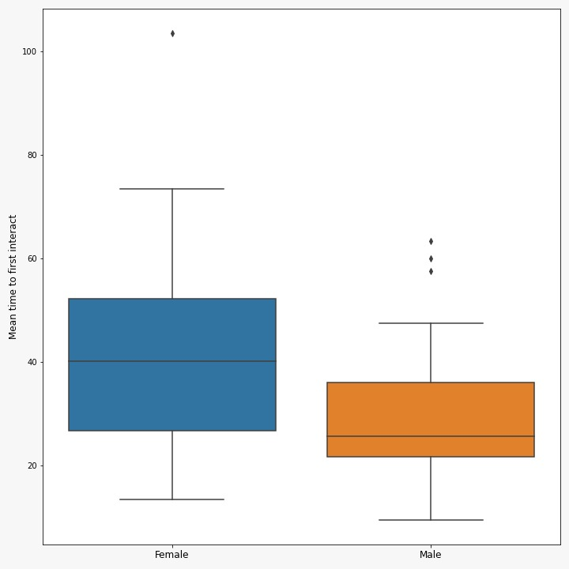
Results
Two-sided Rank-Sum test
↳ p-value = 0.0057

Slide 26
Contents
Add Text
Limitations & Future Work
Motivation
Methodology
Results
Add Text
Research Questions
Study Design
Discussion

Slide 27
Discussion
Gender-Based variations
Perception of Feedback [1]
Alignment with Peer Feedback [2]
Emotional Fallout [2]
[1] Maria Johnson and Vicki S Helgeson. 2002. Sex differences in response to evaluative feedback: A field study. Psychology of Women Quarterly 26, 3 (2002), 242–251.
[2] Margarita Mayo. 2017. The gender gap in feedback and self-perception. https: //hbr.org/2016/08/the-gender-gap-in-feedback-and-self-perception

Slide 28
Contents
Add Text
Limitations & Future Work
Motivation
Methodology
Results
Add Text
Research Questions
Study Design
Discussion

Slide 29
Limitations & Future Work
Limitations
Future Work
No significant correlations among the data
Creation of Oracles → simulation of human teaching behavior
Limited size at hand
Consistent evaluation of algorithms’ performance
Benchmarking
Design of the questionnaire was not overseen by experts
Iterative improvement (Fine-tuning algorithm based on the oracle’s feedback)
Subjectivity in users’ responses to certain questions
Predicting Teachers’ teaching behavior
Another questionnaire before the experiment
Show different psychological factors that might influence teachers’ behaviors
Personalized Learning Experience
Efficient Learning

Slide 30
THANK YOU
Konstantinos Christofi
k.christofi@student.vu.nl

